Slide 1
Line Drawing With Bresenham Algorithm
Patricia Joanne - 140810160065

Slide 2
Source Code
Form1.cs

Slide 3
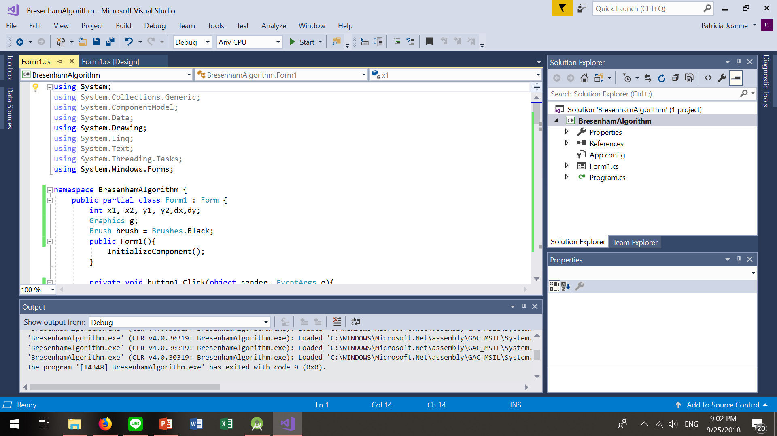
Screenshot

Slide 4
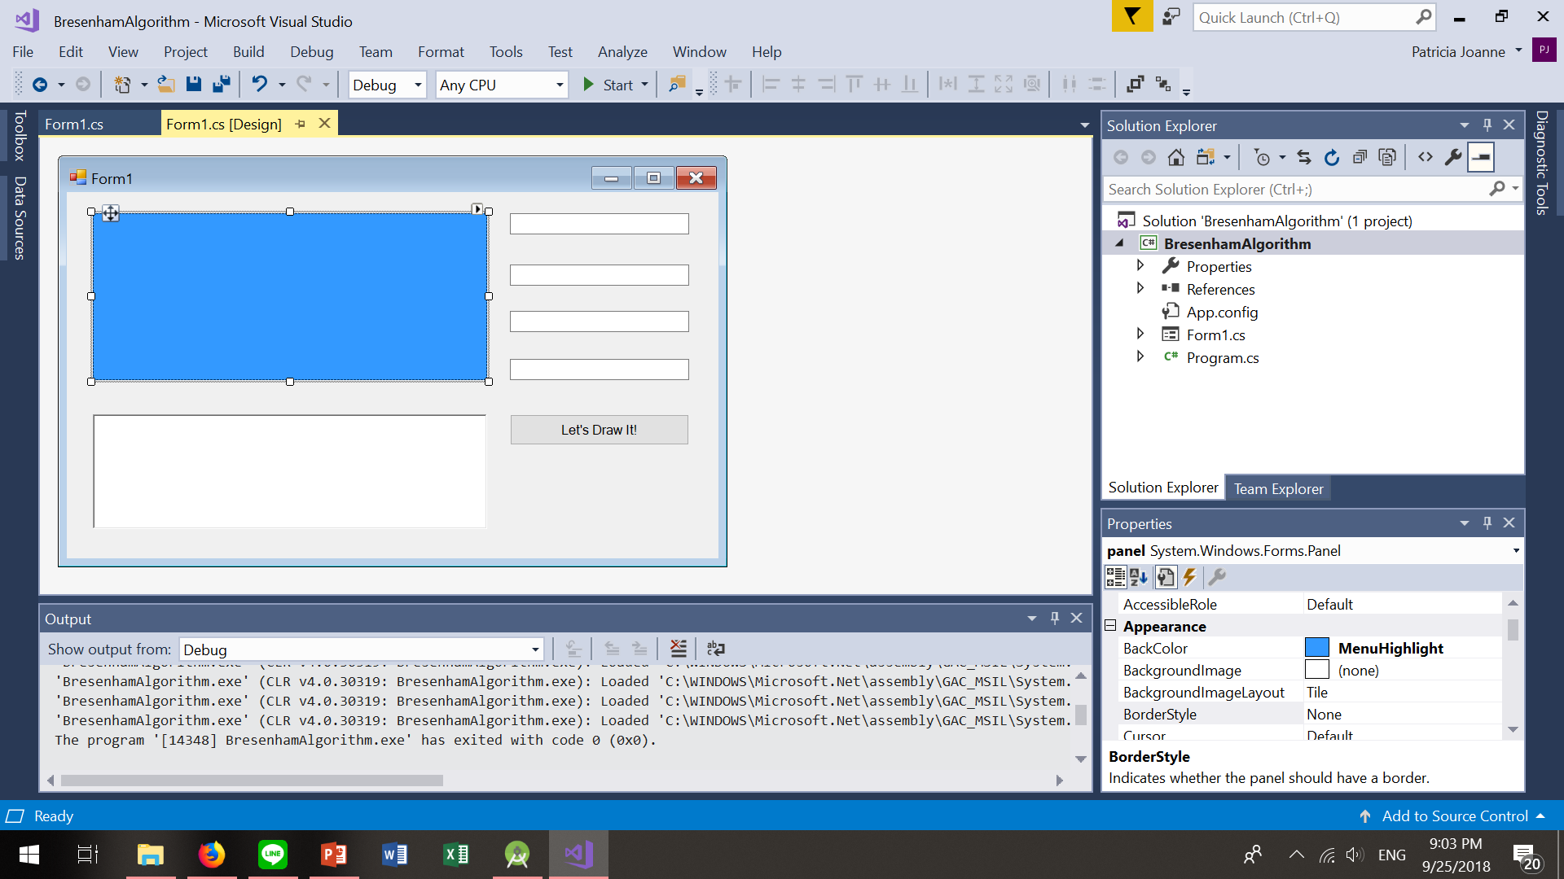
Screenshot

Slide 5
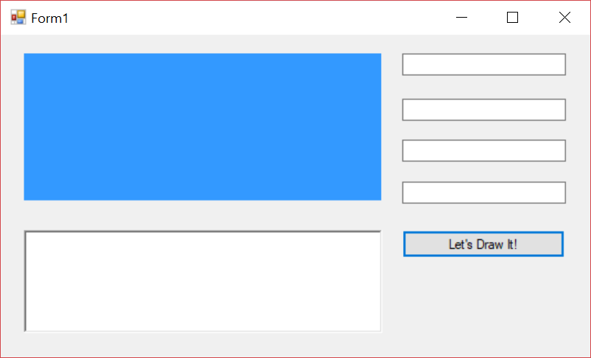
Screenshot
X1
Y1
X2
Y2
Panel
richTextBox

Slide 6
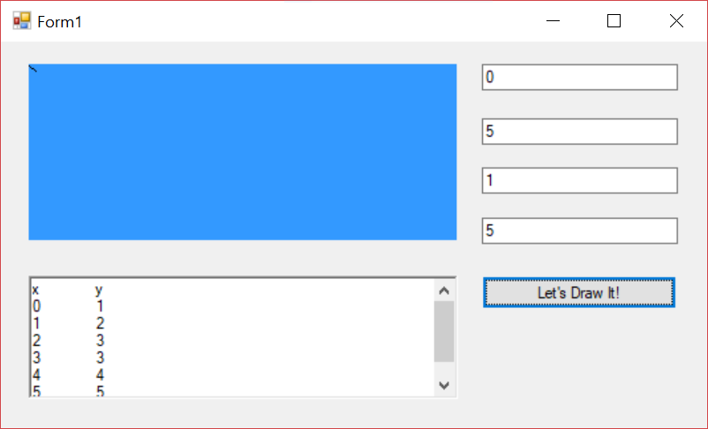
Screenshot (Soal Bagian 3 No 7)
X1
Y1
X2
Y2

